Slide 1
M1W2: Introduction to Visualization
Agenda:
Quick Recap of week 1
Intro to Descriptive Analytics and EDA
Python Libraries: Matplotlib, Seaborn and Plotly
Plot types: Univariate, Bivariate and Multi-variate plots
Practice with 3 Case Studies
Honey Production in the US
Bank Loan Marketing Campaign
IPL 2012 Sports Management Study
Exercise with Movie Ratings and developing a recommendation strategy using EDA (Week 1 & 2 concepts)

Slide 2
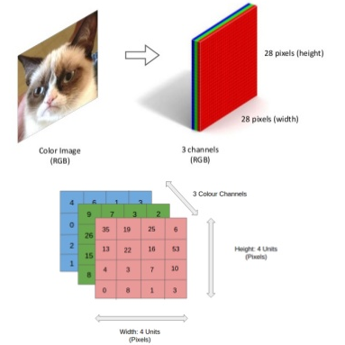
Quick Recap from Week 1 (Refer cheatsheets and links shared for functions)
Numpy- N-d arrays, adv. Math functions and operations
Color Images are represented
as 3D Tensors
Vector
[65. 80. 73. 56. 36. 77.]
Matrix
(1x6)
G H S SS E M
Functions
56. 72. 81. 55. 49. 68.
np.array, np.stack
np.random.randn
np.arrange, np.linspace
np.ones, np.zeros, np.eye
np.sin, np.log10, np.floor, ...
np.dot
np.load
np.save, np.savez
45. 67. 77. 66. 55. 71.
75. 81. 87. 69. 79. 91.
(28x28x3)
52. 61. 57. 49. 41. 68.
(4x6)
Tensor
Math operations: Linear Algebra, Fourier Transform etc

Slide 3
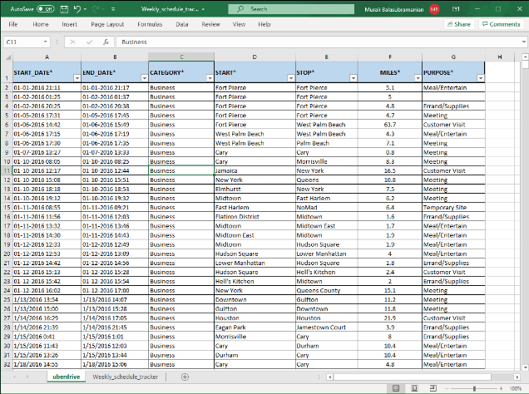
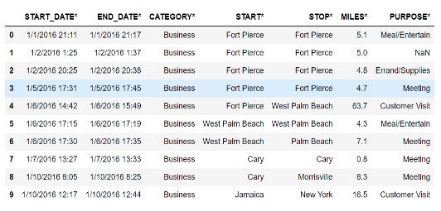

Quick Recap from Week 1 (Refer cheatsheets and links shared for functions)
Pandas- Dataframe, Series, Panel and data manipulation
df [‘?’]
Series: df [‘MILES’]
df
df.iloc(?)
Panel
(Workbook)

Slide 4
Introduction to Visualization
Data visualization is an important skill in applied statistics and machine learning.
It provides an important suite of tools for gaining a qualitative understanding. This can be helpful when exploring and getting to know a dataset and can help with identifying patterns, corrupt data, outliers, and much more.
Visualisation is the most important aspect of exploratory data analysis (EDA)
There are five key plots that you need to know well for basic data visualization. They are:
Line Plot
Bar Chart
Histogram Plot
Box and Whisker Plot
Scatter Plot
4

Slide 5
Where does EDA sit in the Analytics life cycle?
Exploratory data analysis
Data / information
What should be done?
Prescriptive analytics
Descriptive analytics
What is happening?
What could happen in future?
Why did it happen?
Predictive analytics
Diagnostic analytics

Slide 6
What is EDA?
Analyse datasets visually
Summarize main characteristics
Detect anomalies
Visualise patterns / trends

Slide 7
Where does EDA sit in the Data Science Landscape?
Business problem / situation
Raw data collected
Data cleanup / Datapre-processing
Problem definition
Hypothesis testing
Data visualization
Exploratory data analysis
Model buildingModel
Reporting & product development
Model selection
Model Tuning

Slide 8
Objective of EDA
Understand the spread of variables in the dataset
Obtain cues on relationship between variables in a dataset
Detect any outliers in the dataset
Spot missing values in the dataset

Slide 9
Aspects to remember
EDA is a visual examination of the dataset
The observations from EDA need not necessarily be statistically significant
Further statistical models need to be applied to confirm statistical significance

Slide 10
Stages of EDA
Univariate analysis — provides summary statistics for each field in the raw data set
Bivariate analysis — to find the relationship between each variable in the dataset and the target variable of interest
Multivariate analysis — is performed to understand interactions between different variables in the dataset

Slide 11
Types of data
Male, Female
< 18, 18-45, 45-60, >60, >80
Class A, Class B, Class C
Categorical
N, I
Data types
Discrete
Counting process
Numeric
Continuous
Measuring process
Temp in deg C
Population count
R

Slide 12
Matplotlib
The matplotlib provides a context, one in which one or more plots can be drawn before the image is shown or saved to file. The context can be accessed via functions on pyplot. The context can be imported as follows:
from matplotlib import pyplot
There is some convention to import this context and name it plt; for example:
import matplotlib.pyplot as plt
Charts and plots are made by making and calling on context; for example:
pyplot.plot()
12

Slide 13
Seaborn
Seaborn is complementary to Matplotlib and it specifically targets statistical data visualization. But it goes even further than that: Seaborn extends Matplotlib and that’s why it can address the two biggest frustrations of working with Matplotlib. You can import necessary library as follows:
import seaborn as sns
Loading the data:
X= sns.dataset(“x”)
Michael Waskom says in the “If matplotlib “tries to make easy things easy and hard things possible”, seaborn tries to make a well-defined set of hard things easy too.”

Slide 14
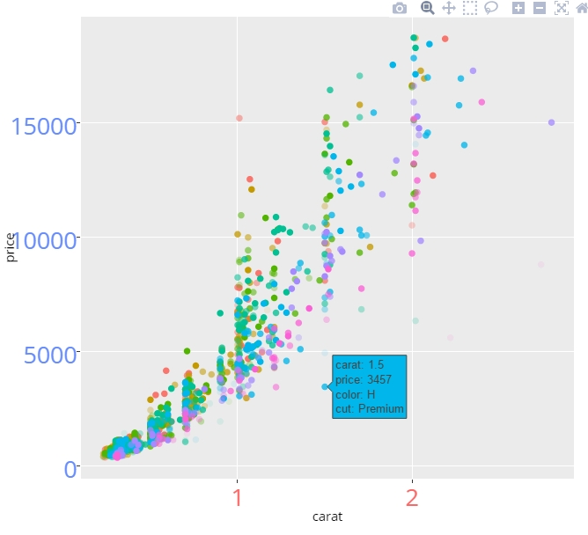
Plotly
Plotly provides a web-service for hosting graphs. Plotly for Python can be configured to render locally inside Jupyter (IPython) notebooks, locally inside your web browser, or remotely in your online Plotly account. You can import necessary library as follows:
import plotly.express as px
import plotly.graph_objects as go
import plotly.io as pio
Here’s how you plot data or a figure:
px.scatter(?)

Slide 15
Chart selection
X Variable | Y Variable | Purpose of analysis | Type of chart | Example
Continuous (numerical) | Continuous (numerical) | How Y changes with X | Scatter plot | How cholesterol varies with Age?
Continuous (numerical) | Categorical | How range of X varies for various category levels | Box plot | Cholesterol variation with Men and Women
Categorical | Categorical | What is the number or % of records of X which falls under each category | Stacked bar | How many men have heart disease compared to women?
Continuous | - | Look at the distribution of the values of the X variable | Histogram, boxplot | Distribution of cholesterol ranges
Impact of 2 X variables on a Y variable |  |  | Facet_grid() | Distribution of chol across mean and women – compared for people who have and don’t have heart disease

Slide 16
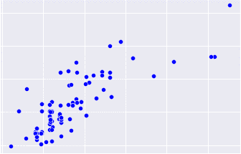
Practical use cases of various visualization techniques
Scatterplot
Relationship between customer age and average call duration in a telecom customer churn dataset
How sales of a product varies with total minutes of advertisement aired
How interest revenue of a customer varies with his annual income in a banks customer dataset
Do cholesterol levels increase / decrease with a person’s blood sugar value?

Slide 17
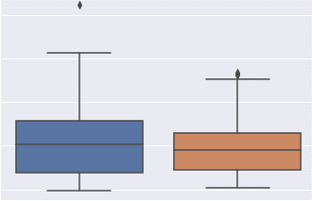
Practical use cases of various visualization techniques
Boxplot
Comparison of incomes of customers who leave and stay with an organisation in a customer churn problem
Comparison of years of experience of people who leave and stay in an organisation in an attrition dataset
Stay
Leave

Slide 18
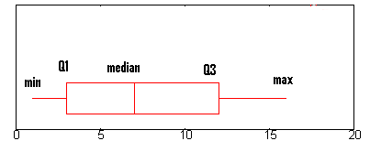
Boxplot and five number summary
Inter Quartile Range (IQR)
25%
50%
75%

Slide 19
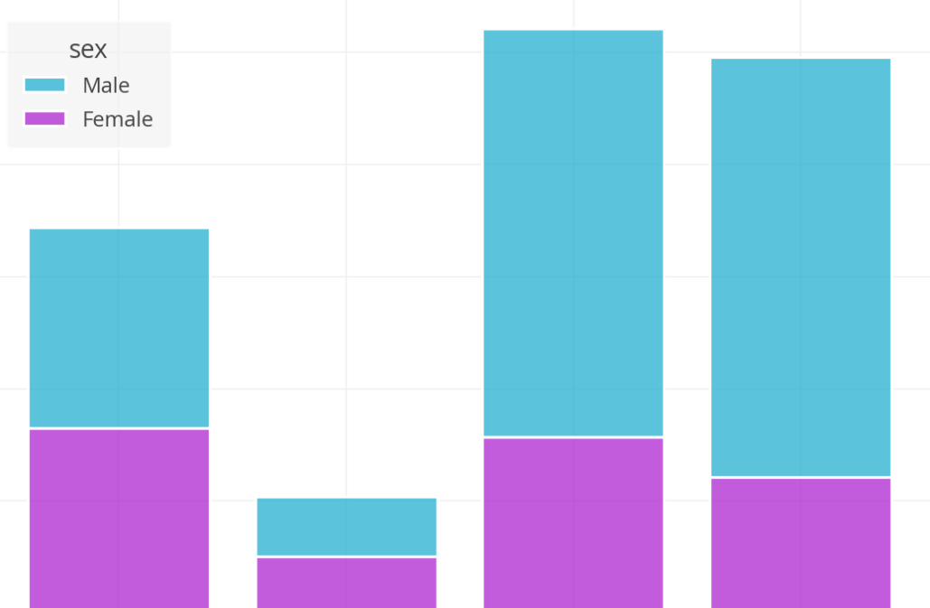
Practical use cases of various visualization techniques
Stacked barplot
Comparison of how % attrition varies between male and female
Comparison of how customer churn varies by gender between 4 different customer plans

Slide 20
Case Study 1
Honey production data set-
This dataset provides insight into honey production supply and demand in USA by state from 1998 to 2012. There was a significant drop in honey production during this period and alarm was raised in 2005-06 to address this.
For Reference: https://www.kaggle.com/arthurpaulino/honey-production/data
Objective: Perform EDA on the dataset to unearth insights regarding the rapid decline in honey production in US from 1998 -2012

Slide 21
Steps: Case Study 1
Import pandas, numpy, seaborn, matplotlib.pyplot packages
Get the data
Explore the data for non-null and extreme values
How many States are included in the dataset?
How many years data is provided in the dataset? And what is the starting and ending year?
Which are the States that are included in this dataset?
Calculate the average production for each state across all years
Study the trends across the key states in terms of production and production value
Study relationship or patterns individually as well as between the various attributes

Slide 22
Case Study 2
Bank Loan Dataset
Thera Bank customer database is used for this study which includes customers with profile attributes and whether they chose to take a personal loan with the bank or not.
Objective: Perform EDA on the dataset to unearth insights regarding the customers and patterns relating to personal loan choice. Eventually, a machine learning model will be built on this dataset to assist with the bank’s marketing campaign to target potential new customers.

Slide 23
Case Study 3
IPL Dataset
IMG- Reliance want to make some key business decisions regarding sponsorships and ad campaigns
Objective: Perform EDA on the dataset to unearth insights regarding the top batsmen from the 2012 season. Eventually, a model will be built to recommend the top 5 batsmen based on various performance attributes which is part of the dataset

Slide 24
Exercise 4 (homework)
Movie lens dataset
Movies and its user ratings are included as 2 datasets (“movie_titles” and “movie_ratings”. Merge and study them.
https://www.kaggle.com/c/movielens-100k
Objective: Based on EDA, recommend data-driven strategy to recommend top 20 movies for general viewer. Use your own criteria for recommendation.

Slide 25
References
http://www.numpy.org/
https://docs.scipy.org/doc/numpy-1.13.0/reference/routines.math.html#trigonometric-functions
https://pandas.pydata.org/pandas-docs/stable/reference/general_functions.html
https://www.kaggle.com/learn/pandas
https://towardsdatascience.com/search?q=pandas%20functions
https://towardsdatascience.com/20-pandas-functions-that-will-boost-your-data-analysis-process-f5dfdb2f9e05
https://www.analyticsvidhya.com/blog/2021/08/must-know-pandas-functions-for-machine-learning-journey/
https://towardsdatascience.com/pandas-full-tutorial-on-a-single-dataset-4aa43461e1e2
https://towardsdatascience.com/5-quick-and-easy-data-visualizations-in-python-with-code-a2284bae952f
https://machinelearningmastery.com/understand-problem-get-better-results-using-exploratory-data-analysis/
https://machinelearningmastery.com/data-visualization-methods-in-python/
https://machinelearningmastery.com/seaborn-data-visualization-for-machine-learning/
https://towardsdatascience.com/the-next-level-of-data-visualization-in-python-dd6e99039d5e

Slide 26

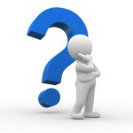
Questions?

